Slide 1
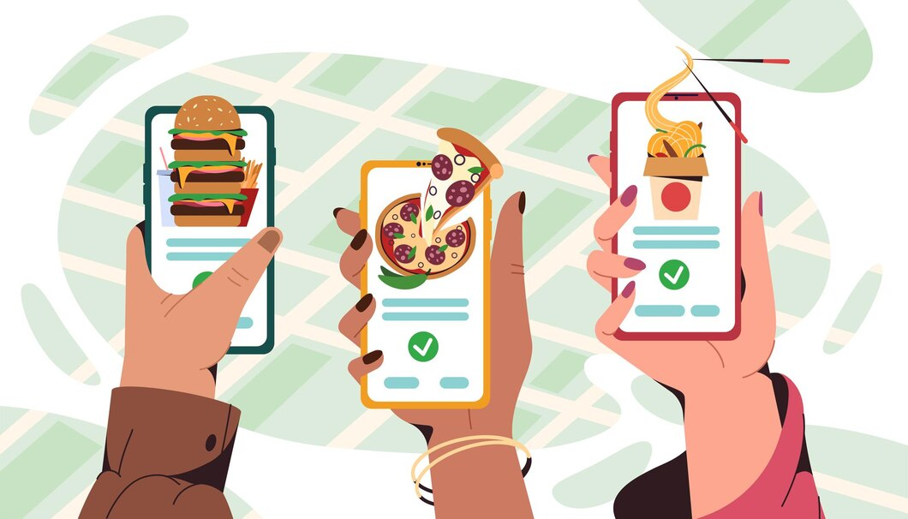




Online Food Ordering System
2023-2024 22SDCS01R- MSWD- CLUSTER2- S24-SDP12

Slide 2


TEAM MATES AND STUDENT MENTOR INTRODUCTION
A group of three people are engaged in developing the Online Food Ordering System, software tools like Visual Studio Code, MongoDB Compass, Postman, Nodemon, Express Generator, React Developer Tools, Redux DevTools, Mongoose, Git & Webpack are commonly used in MERN development.
1. SHAIK SAIMA RIYAAN – Project Lead
In this project, Team Lead Saima directs and coordinates, ensuring our team meets objectives for successful development, implementation, and management of the MERN stack application. She acts as a bridge between team members and higher management, effectively handling challenges with ease.
2. BARNALA BALA VAMSI KRISHNA – Developer
Vamsi, a skilled team member, elevates excellence by crafting and developing MERN stack websites. He adeptly creates technical solutions, resolves errors, and enhances user experience with interactive and real-time features in web browsers.
3. ARIKEPUDI PRATAP – Designer
Pratap, our creative designer, excels in crafting user-friendly web applications using MERN stack (MongoDB, Express.js, React, Node.js). His expertise lies in seamlessly combining technical know-how with design flair, ensuring visually appealing layouts, harmonious color schemes, precise typography, and diverse design components for immersive user experiences.
We have conducted the survey under the guidance of our student mentor YALLAMATI PRAKASARAO.

Slide 3


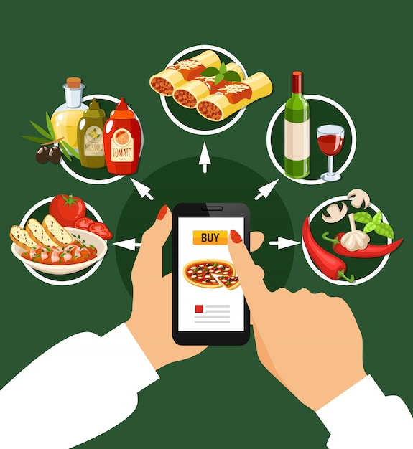
PROJECT DESCRIPTION
The Online Food Ordering System improves the dining experience with convenient, at-home ordering and real-time delivery tracking. It ensures secure payments, fostering trust. For restaurant owners, efficient order processing, menu updates, and customer feedback monitoring contribute to agile and responsive operations. Overall, it blends customer ease, enhanced management, and streamlined delivery for optimal efficiency in the food industry.

Slide 4
ADVANTAGES AND DISADVANTAGES OF ONLINE FOOD ORDERING SYSTEM
ADVANTAGES
Convenience
Time Efficiency
Real-Time Tracking
Secure Payments
Customization
Increased Sales
DISADVANTAGES
Technical Glitches
Dependency on Internet
Delivery Challenges
Quality Concerns
Data Security
High Competition

Slide 5

ABOUT CONDUCTION SURVEY
We've launched a survey dedicated to the Online Food Ordering System, focusing on crucial questions crafted to propel advancements within our project. The survey is designed to collect insights aimed at refining and improving the application's functionality. Our goal is to actively solicit valuable feedback through this survey, aiming to bolster the capabilities of the Online Food Ordering System for a more effective and responsive system.
LinkedIn:
Link:
https://forms.office.com/r/VdDQYxHj4H

Slide 6

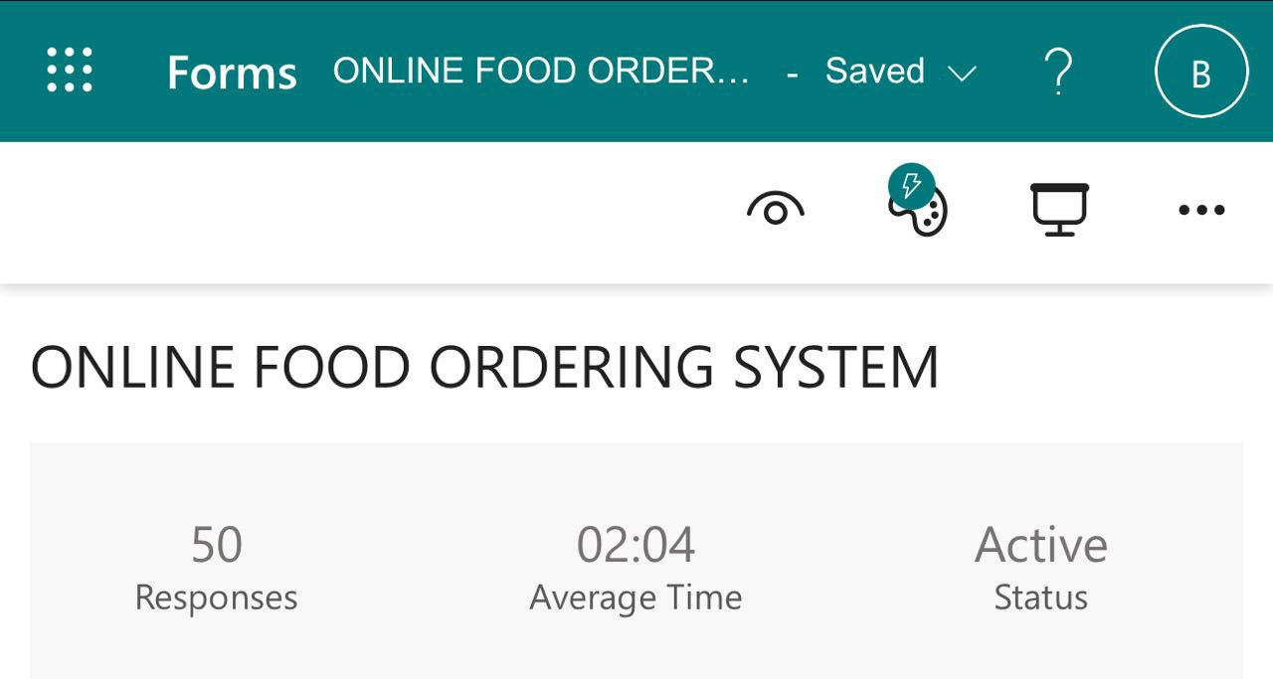
SURVEY RESPONSES
Our conducted survey received a total of 50 responses, reflecting active engagement from participants. This substantial response provides a meaningful dataset for our analysis. We appreciate the participation and valuable input from those who took part in the survey.

Slide 7

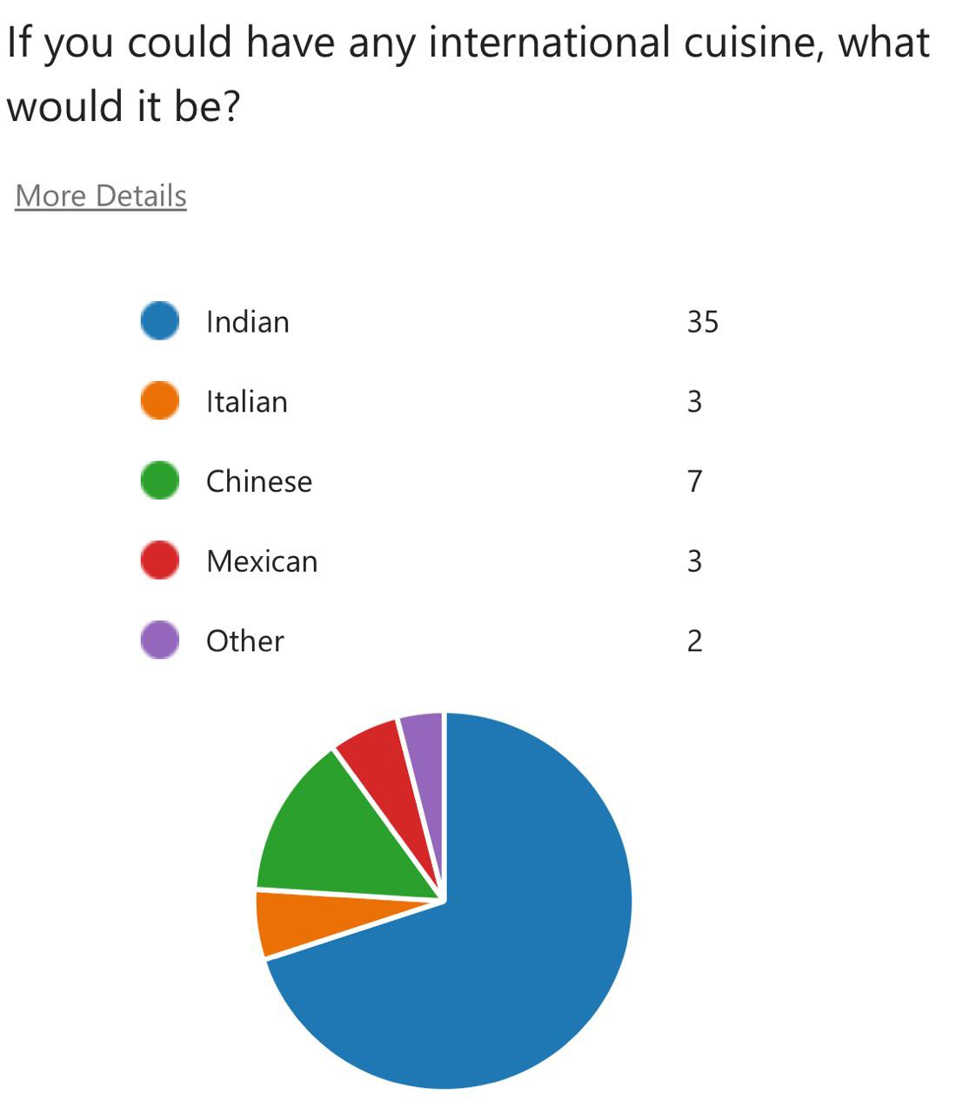
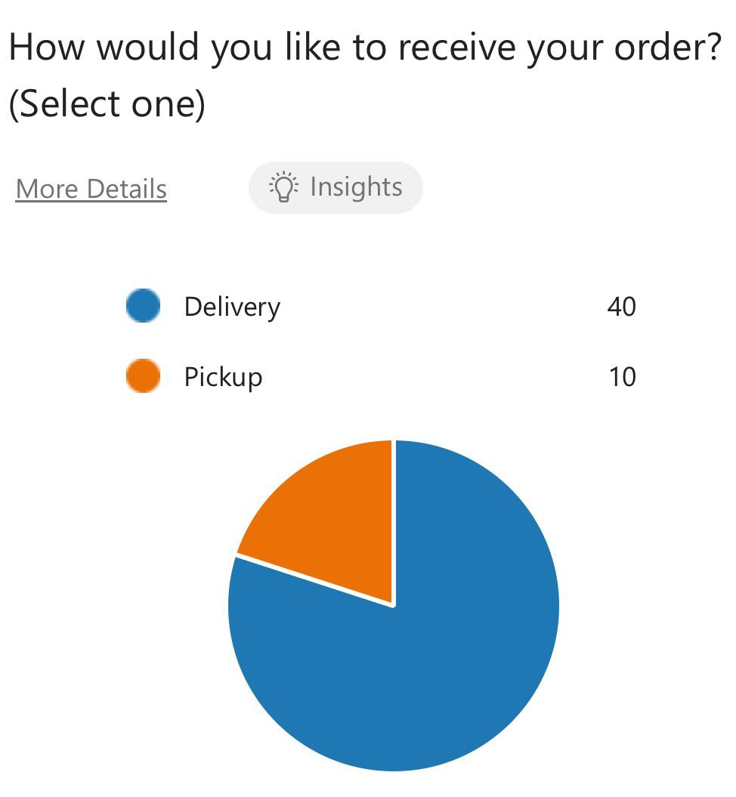
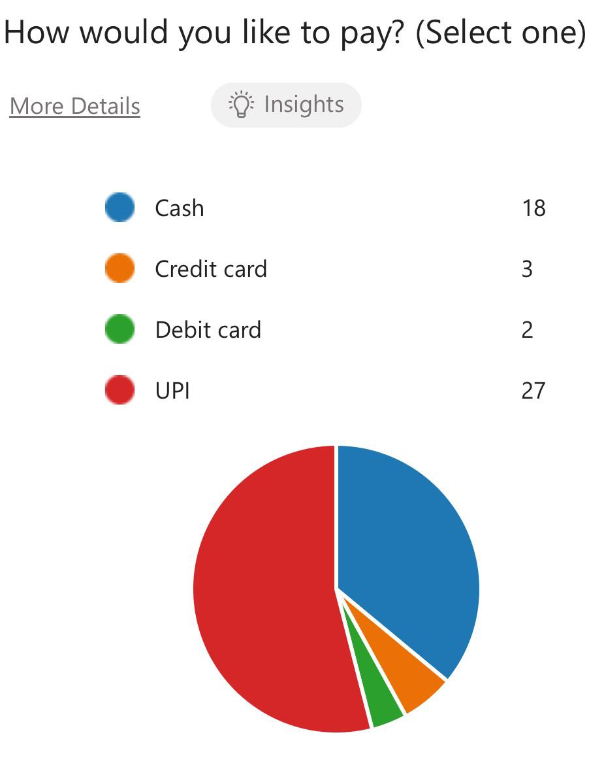
ANALYTICS THROUGH CHAT BASED SURVEY RESULTS

Slide 8
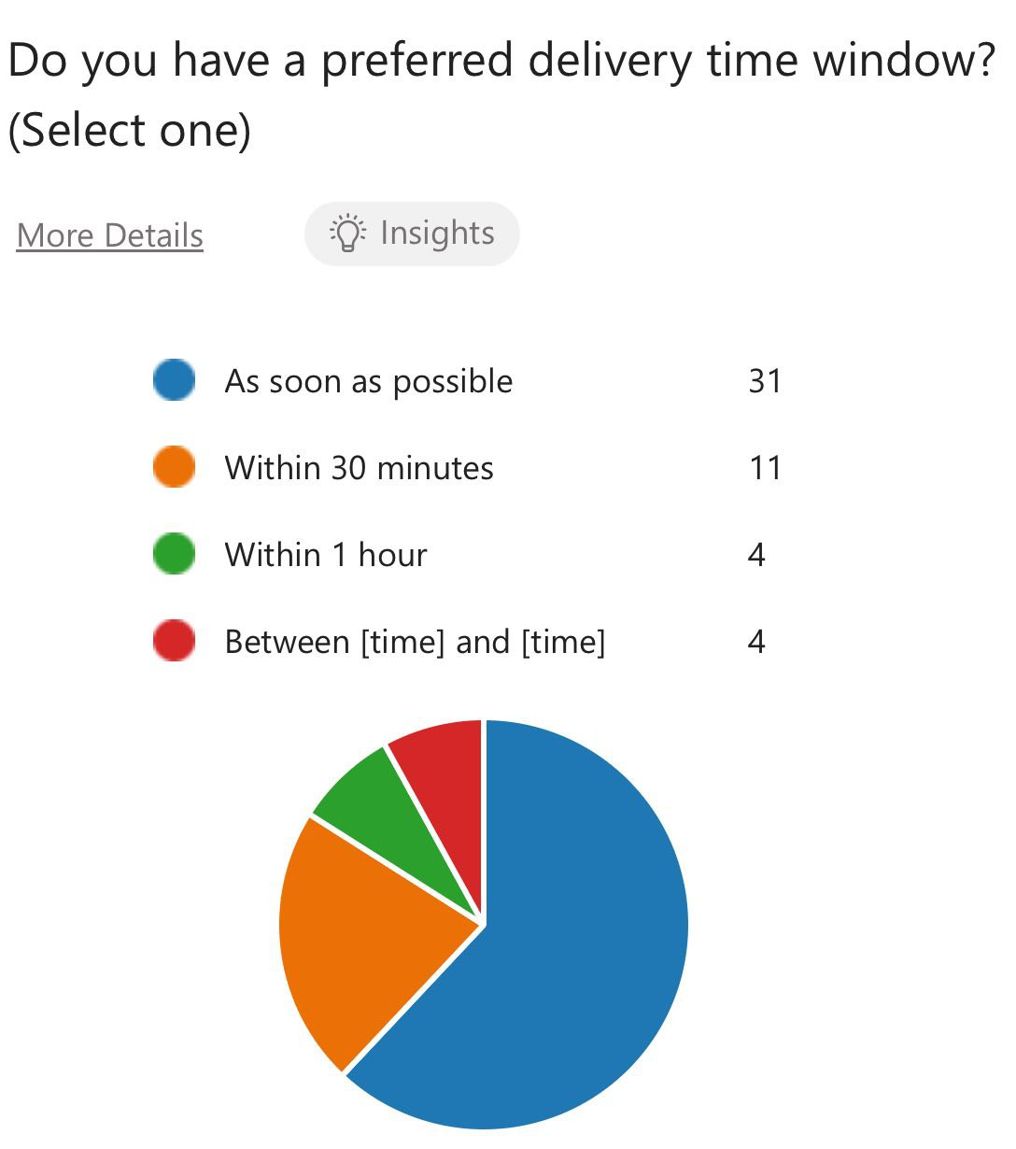
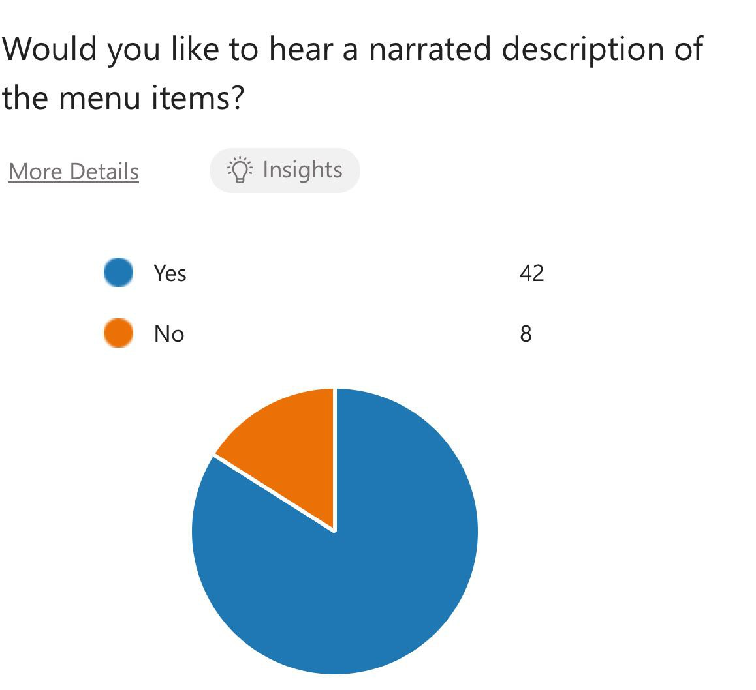
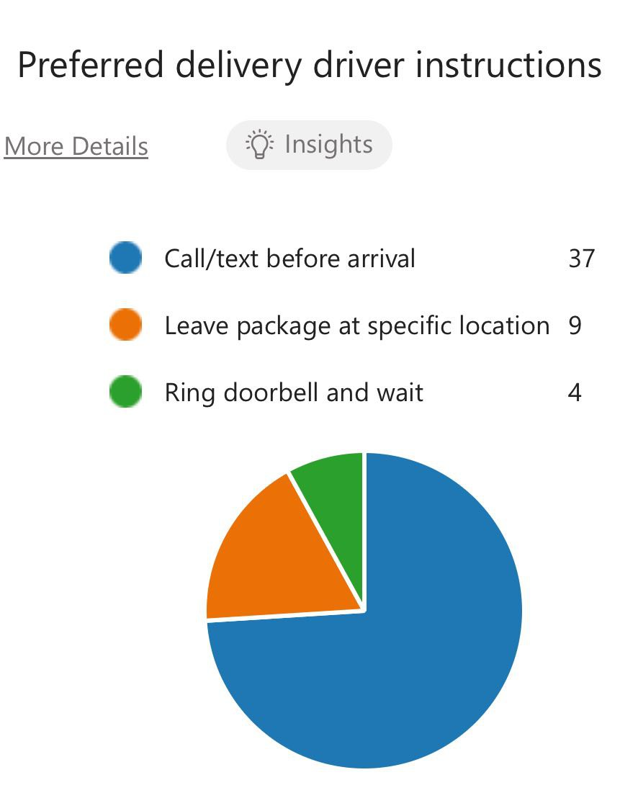
ANALYTICS THROUGH CHAT BASED SURVEY RESULTS

Slide 9


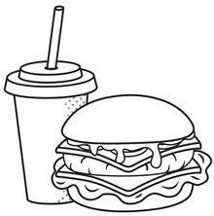

GOALS & OBJECTIVES
Efficient Ordering
Optimized Operations
Secure Transactions
Streamline the process for customers to conveniently order food online, enhancing the overall user experience.
Enable restaurant owners to efficiently manage menus, process orders, and monitor feedback, promoting agile and responsive business operations.
Implement a secure payment gateway to ensure smooth and protected financial transactions, fostering trust and reliability in the online food ordering process.

Slide 10
FEATURES OF ONLINE FOOD ORDERING SYSTEM
User-Friendly Interface: The system offers an intuitive and easy-to-navigate interface for seamless user experience.
Menu Browsing: Customers can browse digital menus with detailed descriptions, images, and prices of available dishes.
Order Placement: Users can place orders effortlessly, selecting desired items and specifying preferences.
Real-Time Order Tracking: A feature that allows customers to track the status and location of their orders in real-time.
Secure Payment Gateway: Integration of a secure online payment system for smooth and protected financial transactions.
Account Management: Customers can create accounts, manage profiles, and store delivery preferences for a personalized experience.
Promotions and Discounts: The system supports the implementation of promotional offers, discounts, and loyalty programs to enhance customer engagement.
Feedback and Ratings: Users can provide feedback, ratings, and reviews, contributing to a transparent system and helping others make informed choices.

Slide 11
FEATURES OF ONLINE FOOD ORDERING SYSTEM
Admin Dashboard: A robust dashboard for restaurant owners/administrators to manage menu items, prices, and monitor overall system activity.
Inventory Management: Enables restaurant owners to efficiently manage and update available food items and quantities.
Order Processing: Streamlines the order processing workflow, from confirmation to preparation and delivery.
Customer Support: Integration of customer support features such as chat support or helpline for addressing queries and concerns.
Responsive Design: Ensures compatibility across various devices, providing a consistent experience on smartphones, tablets, and computers.
Delivery Management: Tools for restaurants to coordinate and optimize the delivery process, including route planning and delivery tracking.
Reporting and Analytics: Generates reports and analytics for restaurant owners to gain insights into sales, popular dishes, and customer preferences.

Slide 12
CUSTOMER JOURNEY MAP OF ONLINE FOOD ORDERING SYSTEM
Awareness:
Touchpoints: Online advertisements, social media promotions, word-of-mouth.
Customer Actions: Users become aware of the platform through marketing efforts and recommendations.
Research and Exploration:
Touchpoints: Website/app exploration, reviews and ratings, menu browsing.
Customer Actions: Potential customers explore the platform, check menus, read reviews, and assess the overall user experience.
Registration/Account Creation:
Touchpoints: Account setup page on the app/website.
Customer Actions: Users create an account, providing necessary details for a personalized experience.
Menu Selection:
Touchpoints: Interactive menu interface.
Customer Actions: Customers browse the menu, select items, and customize orders according to preferences.
Adding to Cart:
Touchpoints: Cart icon on the interface.
Customer Actions: Users review their selected items, make adjustments, and add them to the virtual cart.
Order Placement:
Touchpoints: Checkout page.
Customer Actions: Customers confirm their orders, choose delivery options, and proceed to payment.

Slide 13
CUSTOMER JOURNEY MAP OF ONLINE FOOD ORDERING SYSTEM
Payment Process:
Touchpoints: Secure payment gateway.
Customer Actions: Users enter payment details and complete the transaction, ensuring a smooth and secure process.
Order Confirmation:
Touchpoints: Confirmation page and email/SMS notifications.
Customer Actions: Confirmation of the placed order and receipt is provided, ensuring transparency.
Food Preparation:
Touchpoints: Order processing interface for restaurant staff.
Customer Actions: Behind-the-scenes as the restaurant prepares the order.
Delivery Tracking:
Touchpoints: Real-time tracking on the app.
Customer Actions: Users can track their order, knowing the exact status and estimated delivery time.
Food Receipt:
Touchpoints: Delivery confirmation notification.
Customer Actions: Receipt of the ordered food, signaling successful completion.
Post-Delivery Feedback:
Touchpoints: In-app feedback form or notification.
Customer Actions: Users may leave feedback, providing valuable insights for the platform and future customers.

Slide 14


USER PERSONA
Name: Emily Rodriguez
Age: 30
Occupation: Marketing Executive
Goals:
Save Time: Emily is a busy professional with a demanding job. She aims to save time by easily ordering meals online without the hassle of cooking or going to a restaurant.
Convenience: Emily values convenience and wants a seamless online food ordering experience that fits into her hectic schedule.
Varied Options: She enjoys exploring different cuisines and expects the online platform to provide a diverse range of restaurant options with detailed menus.
Healthy Choices: Emily is health-conscious, and she looks for restaurants that offer nutritious and well-balanced meal options.

Slide 15
USER PERSONA
Challenges:
Time Constraints: Limited time during workdays makes it challenging for Emily to prepare meals at home.
Decision Fatigue: With a busy lifestyle, Emily often faces decision fatigue and prefers a user-friendly platform with clear menu options.
Dietary Preferences: Emily follows a specific dietary plan and expects the online system to allow customization and filter options based on dietary preferences.
Behaviors:
Tech-Savvy: Emily is comfortable using mobile apps and websites for various purposes, including online shopping and food ordering.
Social Media Presence: She often discovers new restaurants and food trends through social media platforms.
Loyalty: Emily appreciates loyalty programs and discounts, making her more likely to be a repeat customer if rewarded for her orders.
With these traits in mind, the Online Food Ordering System should prioritize a user-friendly interface, diverse restaurant options, customization features, and loyalty programs to cater to Emily's preferences and enhance her overall dining experience.

Slide 16



ONLINE RESEARCH : ONLINE FOOD ORDERING SYSTEM
As of my last knowledge update in January 2024, We can provide general information on online food ordering systems, However, we can easily find popular online food ordering platforms by searching on app stores or websites. Here are some well-known platforms:
UberEats
GrubHub
DoorDash
https://www.ubereats.com/
https://www.grubhub.com/
https://www.doordash.com/

Slide 17



ONLINE RESEARCH : ONLINE FOOD ORDERING SYSTEM
Please note that the availability of these platforms may vary depending on your location, and there might be new platforms that have emerged since my last update. Always download apps from official app stores to ensure security.
PostMates
Zomato
Swiggy
https://postmates.com/
https://www.zomato.com/
https://www.swiggy.com/

Slide 18
MODULES INCLUDE IN ONLINE FOOD ORDERING SYSTEM
User Registration and Authentication: Enables customers to create accounts and authenticate their identities for secure access.
Menu Browsing: Allows users to view a comprehensive menu with detailed descriptions, images, and prices of available food items.
Order Placement: Facilitates users in selecting desired items, specifying quantities, and placing orders seamlessly.
Shopping Cart: Manages and displays selected items, quantities, and prices before users proceed to checkout.
Payment Gateway: Integrates a secure platform for users to make online payments, ensuring smooth and protected financial transactions.
Order Confirmation: Sends confirmation notifications to users upon successful order placement, summarizing the details of their order.
Real-time Order Tracking: Allows users to monitor the status and location of their orders in real-time for enhanced transparency.
Admin Dashboard: Provides restaurant administrators with tools to manage menu items, update prices, and monitor and process incoming orders.

Slide 19
MODULES INCLUDE IN ONLINE FOOD ORDERING SYSTEM
Inventory Management: Assists restaurant owners in tracking and managing their inventory, ensuring that the menu reflects available items.
Customer Feedback and Ratings: Allows customers to provide feedback and ratings for the food and service, providing valuable insights for improvement.
Discounts and Promotions: Incorporates features for offering discounts, promotions, and special deals to attract and retain customers.
Reports and Analytics: Generates reports and analytics for restaurant owners to assess sales trends, popular items, and overall system performance.
Delivery Management: Helps in managing and tracking the delivery process, assigning orders to delivery personnel, and estimating delivery times.
Notifications and Alerts: Sends automated notifications and alerts to users regarding order confirmation, delivery updates, and promotions.
Customer Support: Integrates a customer support module to address queries, concerns, and provide assistance to users in real-time.

Slide 20
CONCLUSION
The Online Food Ordering System revolutionizes dining with seamless, at-home access, real-time tracking, and secure payments. For restaurants, it streamlines operations through efficient order processing and dynamic management tools. This comprehensive solution redefines the food industry, delivering convenience, trust, and operational excellence to both customers and establishments alike.

Slide 21

THANK YOU
We extend our sincere gratitude for the successful completion of the Online Food Ordering System project. Your dedication and contributions have played a pivotal role in creating a user-friendly platform that enhances the dining experience for customers and streamlines operations for restaurant owners. Thank you for your valuable efforts in bringing this project to fruition.

